Slide 1
Cloud Services
Group O - Eric Prytulla, Mintaha Tekdemir

Slide 2
Breakdown
Implementation
Scan
Lesson learnt
Live Demo

Slide 3
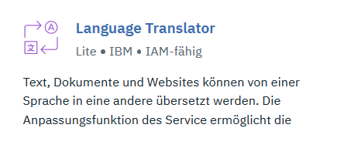
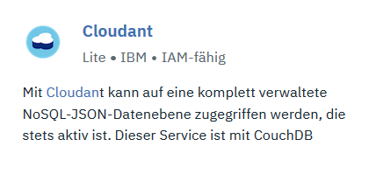
Implementation
Cloud Services

Slide 4
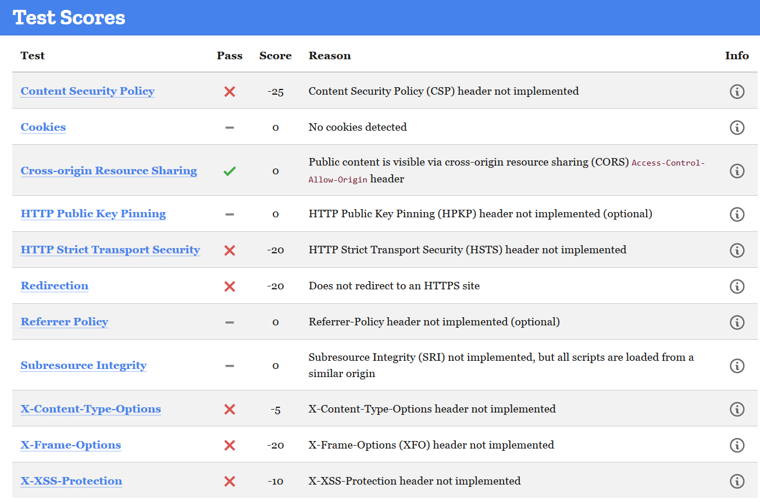
Scan

Slide 5
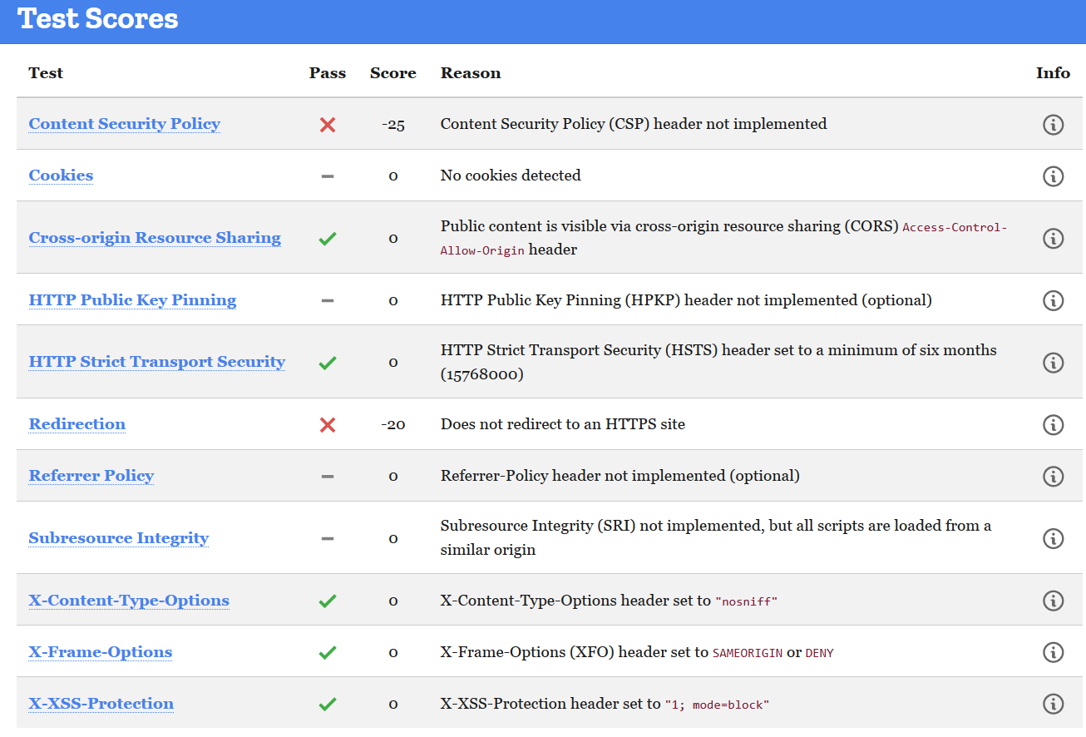
Scan

Slide 6
Lesson learnt
modules are doing everything

Slide 7
Live Demo

